Slide 1
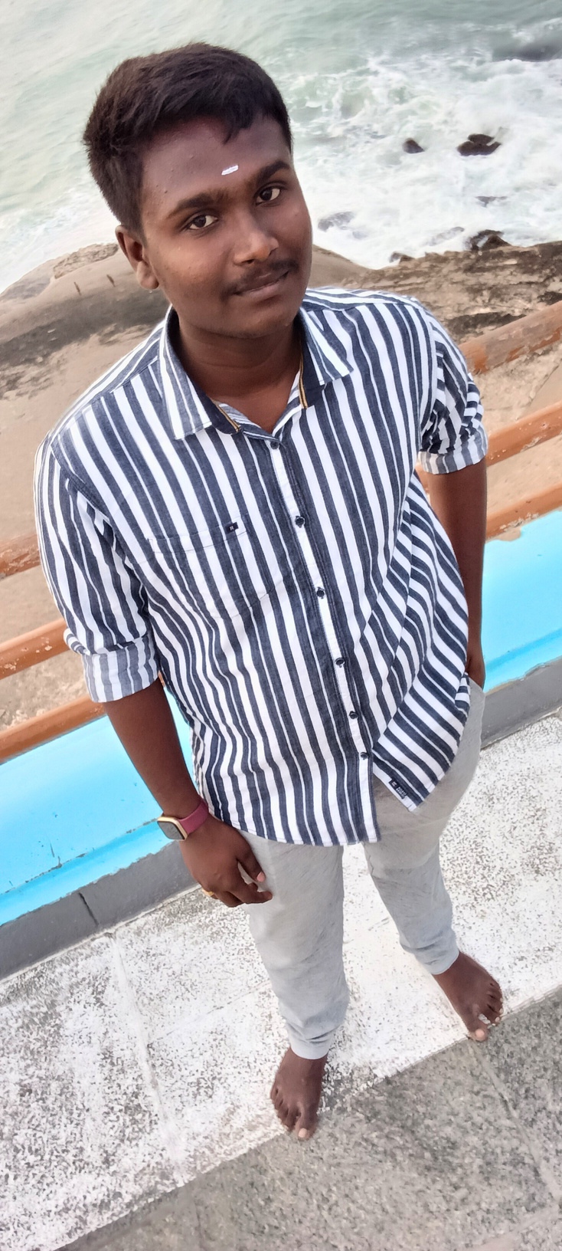
Digital Portfolio
Student Name: Sugapriyan P G
Register no and naan mudhalvaan id:2422k1904/asbru062422k1904
Department:BSC.Computer Science
Collage/University : chikkanna Government Arts Collage /Bharathiar University.
Page:01

Slide 2
PROJECT TITLE
Portfolio website project
Page:02

Slide 3


AGENDA
1.Problem Statement
2.Project Overview
3.End Users
4.Tools and Technologies
5.Portfolio Design And Layout
6.Features And Functionality
7.Results and Screenshots
8 Conclusion
9.Github Link
Page:03

Slide 4

PROBLEM STATEMENT
Many students and freshers struggle to showcase their skills to recruiters.
traditional resumes do not effectively highlight products and creativity.
Lack of online presence reduces visibility and opportunities.
Difficulty in presenting projects in a professional, structured format.
Page:04
Notes:
Many students and recent graduates struggle to effectively showcase their skills to recruiters due to:
- Traditional resumes not highlighting creativity and project achievements.
- Limited online presence reducing visibility and opportunities.
- Difficulty in presenting projects professionally and in an organized manner.

Slide 5
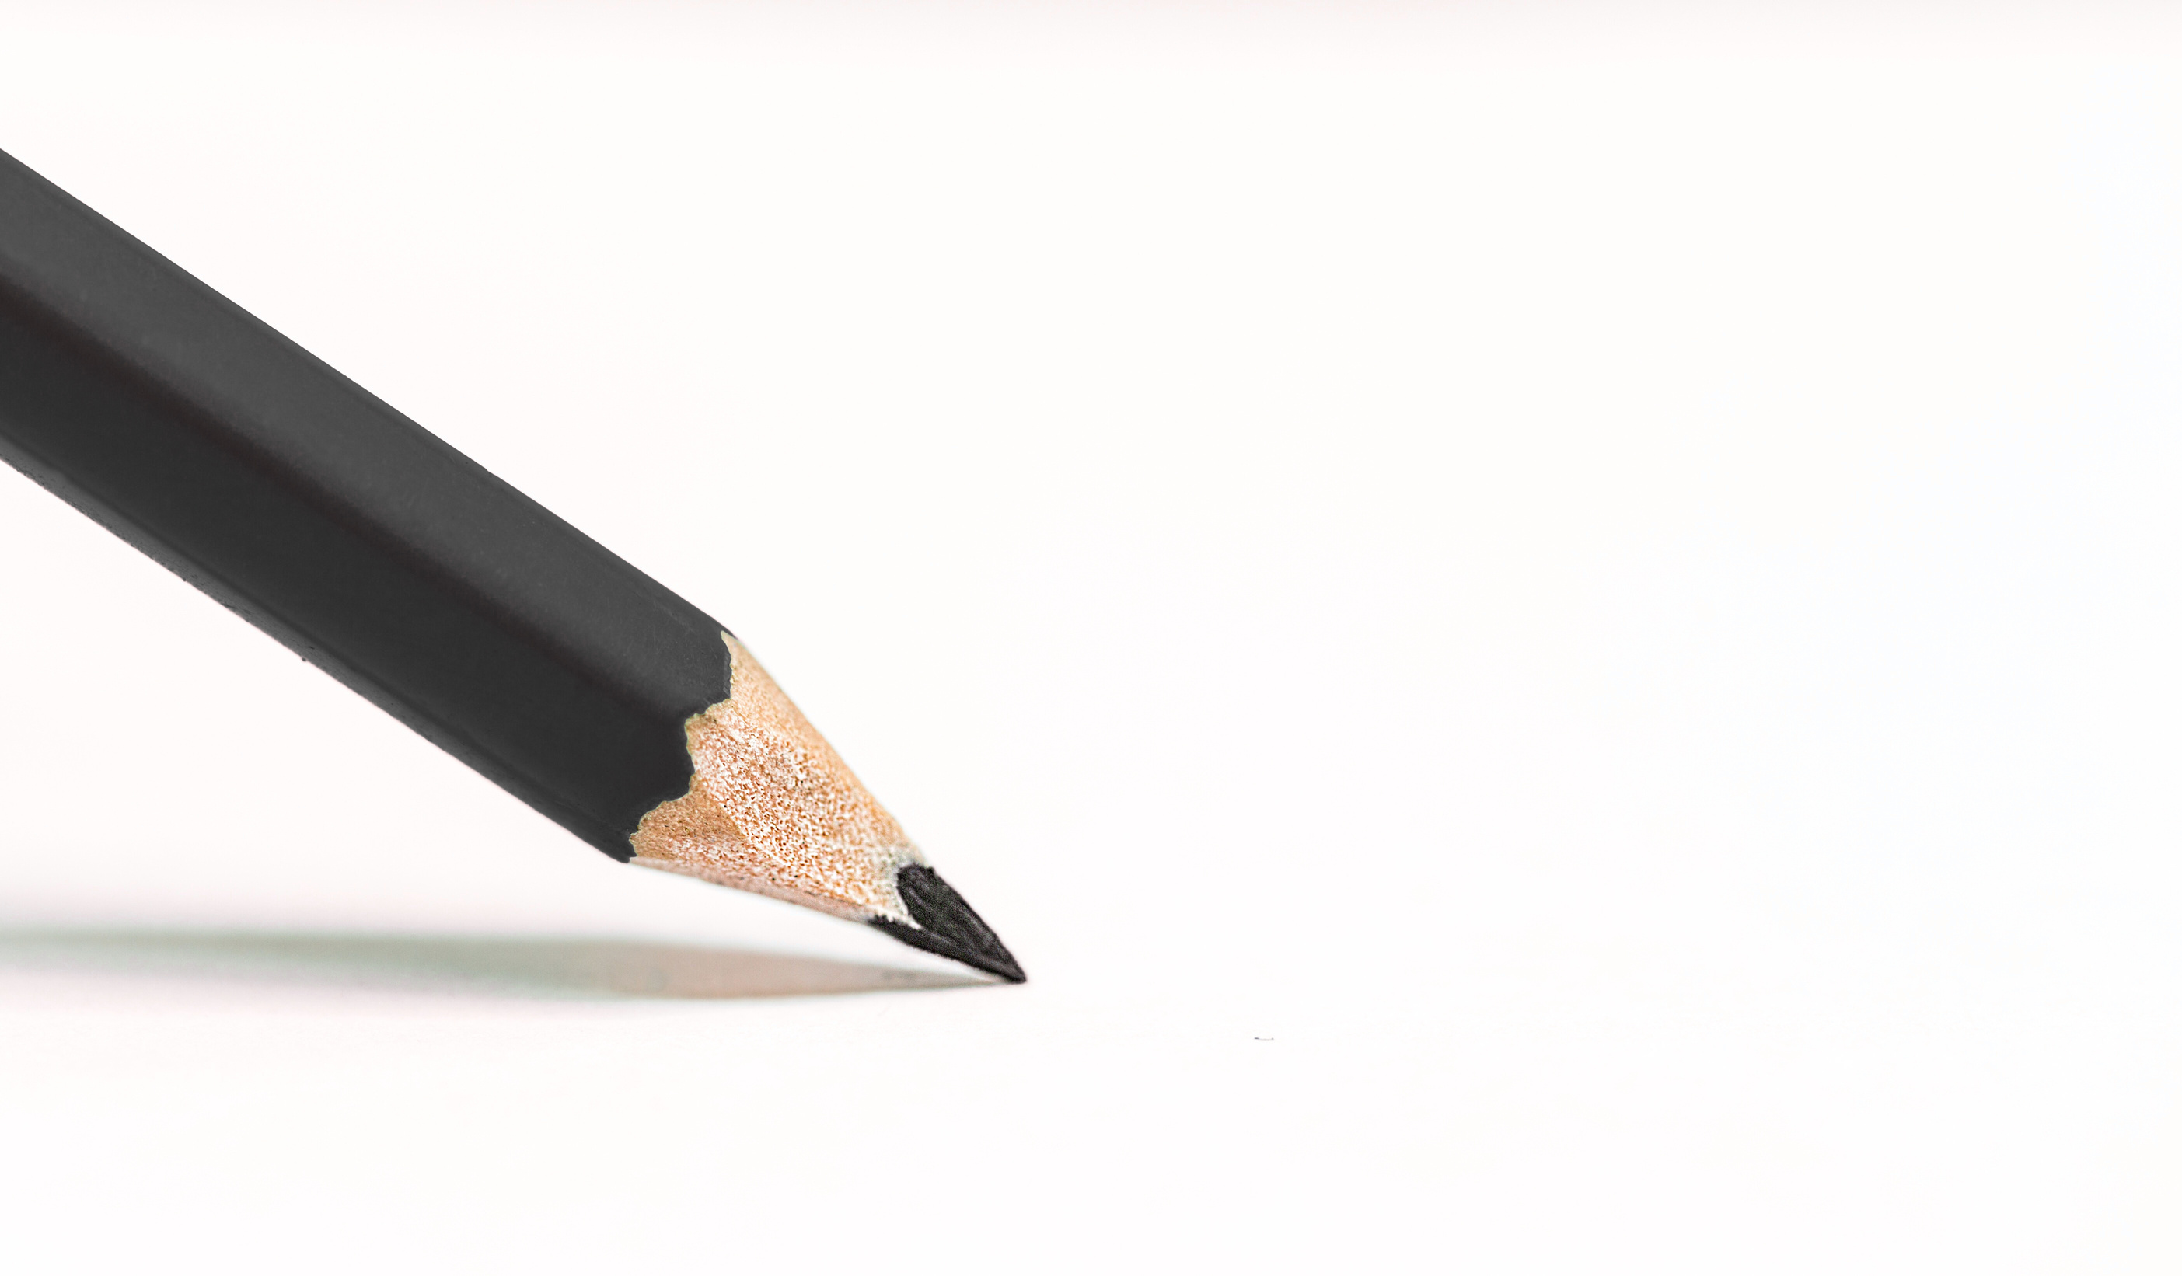
PROJECT OVERVIEW
A personal portfolio website that highlights skills,projects,education, ancontact details.
Designed with a modern,responsive and user friendly interface.
provides a centralised platform to share work with recruits,peers,and mentors.
page:05

Slide 6

END USERS?
* Recruiters/Employers – to quickly evaluate skills and projects.
* peers &collaborators – for networking and collaboration.
* Academic mentors – to assess student Achievements and growth.
Page;06

Slide 7

TOOLS AND TECHNOLOGIES
Frontend:HTML5,CSS3,javascript
IDE:visual studio code
version control:Got &GitHub
Design Tools:Figma/Canva(for layout, optional)
Hosting(optional): Github Pages/Netlify

Slide 8

PORTFOLIO DESIGN AND LAYOUT
Home / About Me - introduction,photo,tagline.
Skills- Technical skills with tags or progress bars.
projects - showcase of completed projects with descriptions &links.
contact - Email,phone,social media links.
Footer - Copyright + GitHub/Linkedin links .

Slide 9

FEATURES AND FUNCTIONALITY
responsive design - works on desktop, tablet,and mobile.
interactive ui - clean cards,hover effects,icons.
contact options - mail and phone links ,social icons.
Project showcase - description + GitHub link for source code.
Easy navigation - clear sections with smooth layout.

Slide 10
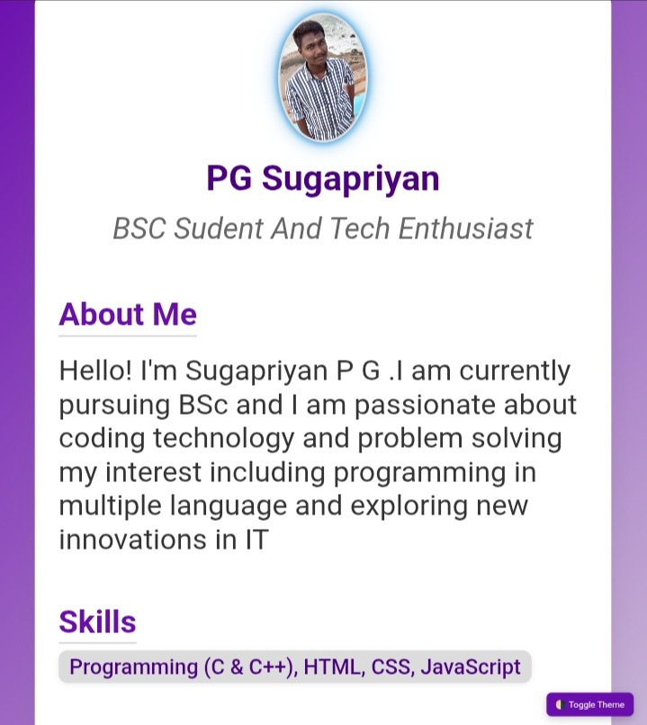
RESULTS AND SCREENSHOTS

Slide 11

CONCLUSION
Built a professional,responsive,and user - friendly portfolio.
Helps in career growth by showcasing skills and projects effectively.
Easy for recruiters and mentors to evaluate abilities.
Future scope: Add backend integration (blogs,CMS,or dynamic project uploads).

Slide 12
GITHUB LINK
https://github.com/sugapriyan87317-cyber/Sugapriyan-TNSTC-FWD-DP.git

Slide 13


